Slide 1
Perfect Sports Arena: San Antonio, TX
By: Andrew Robinson

Slide 2
OVERVIEW/BACKGROUND
In the Nation Basketball Association (NBA), the arenas that each team plays in typically are in the downtown of the city.
As a fan of the NBA and more specifically the San Antonio Spurs, I enjoy going to games in person since I live in the same city. The AT&T Center is the name of the arena that the San Antonio Spurs play in.
However, unlike other arenas for other teams in the league, the AT&T center is not even located in downtown San Antonio. It is located approximately 5 miles from downtown.
The question then becomes: Would it make more sense to have a sports arena that is located downtown as opposed to its current location.

Slide 3
HOW DATA CAN BE USED
For this report I will use San Antonio location data to visualize the neighborhood and venue densities of both the area surrounding the AT&T Center and downtown San Antonio.
If downtown is more densely populated with neighborhoods and venues, then that could lead to an economic incentive to have an arena in that area.

Slide 4
Methodologies
First, all the data I will obtain to perform analysis on, will be received from the Foursquare API.
With the folium library, I will visualize the venues around both the AT&T Center and the Riverwalk which are both located in San Antonio, TX.
To cluster venues that are close together, I will use the K-Means clustering algorithm.
Ultimately, will want to determine which location (the AT&T Center or the area around the Riverwalk) would be best start a new business or build a new basketball arena.

Slide 5
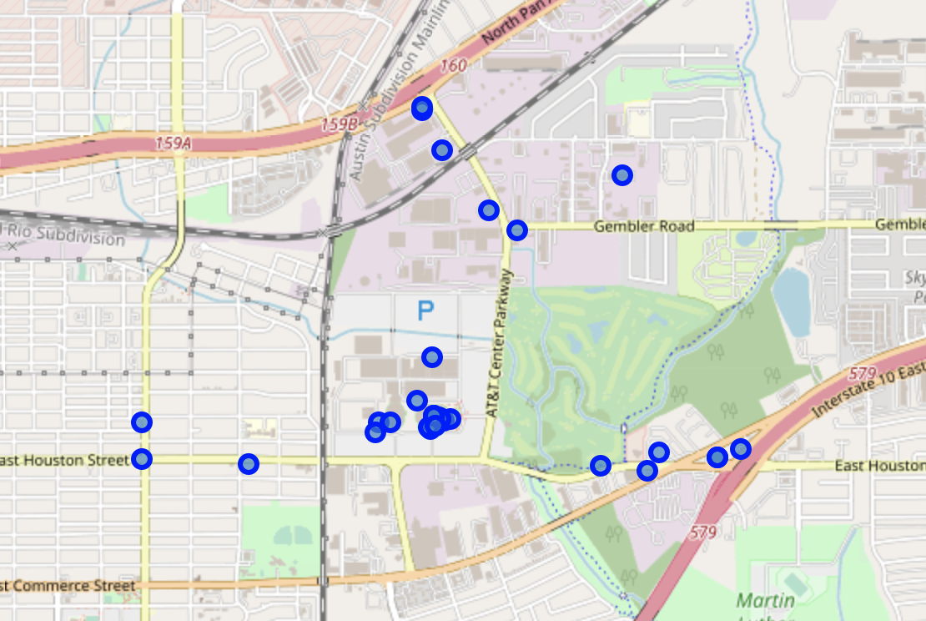
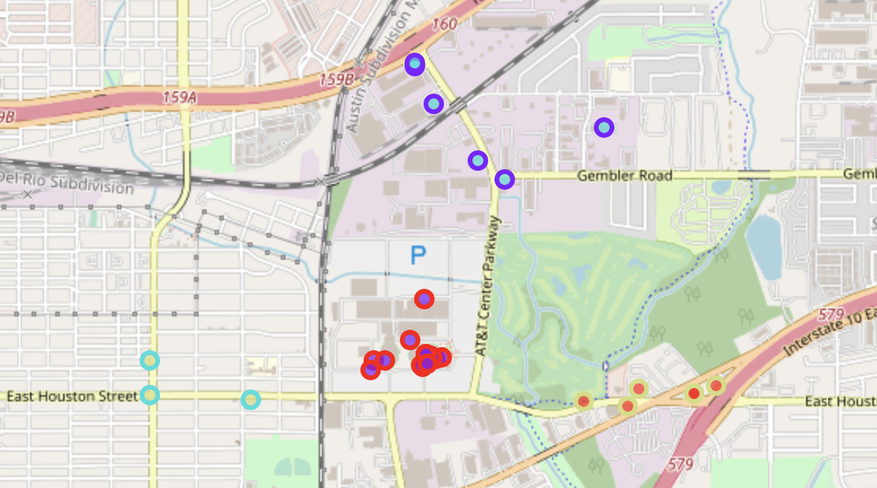
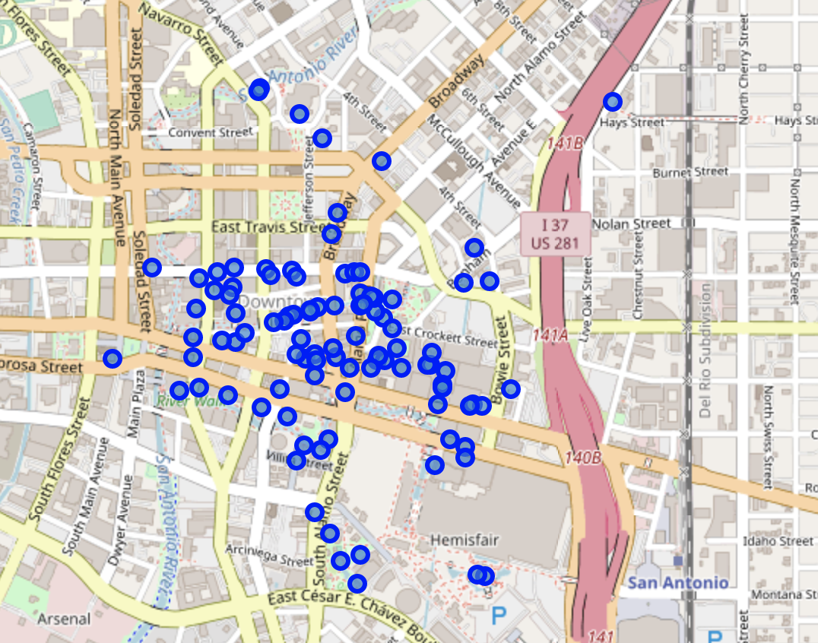
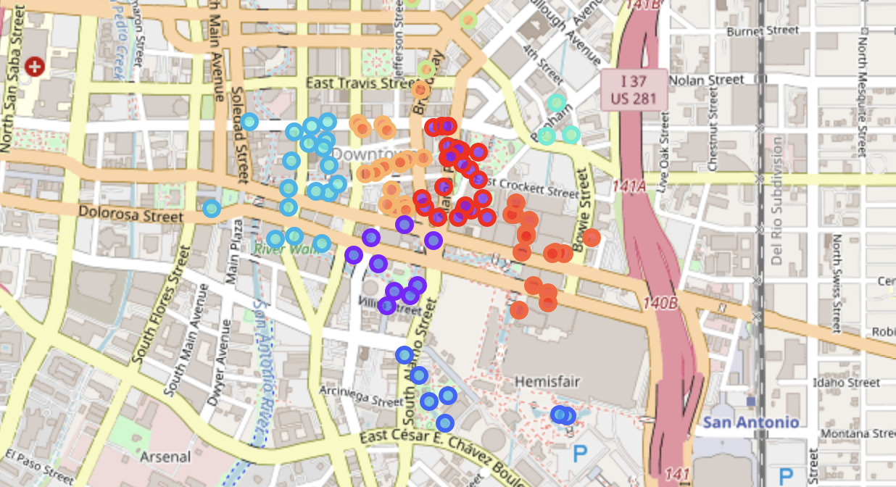
Analysis
Used folium to visualize both locations
With K-Means clustering, clustered venues
Determined 4 clusters for AT&T and 9 clusters for Riverwalk
Riverwalk had 39 more venues within one mile
Riverwalk also had 17 more hotels within one mile.

Slide 6
Results
By counting the number of venues within one mile of both the AT&T Center and the Riverwalk, it is determined that the Riverwalk has 100 venues and the AT&T Center has 31 venues that fit that criteria.
This means, the Riverwalk is within one mile of 69 more venues than the AT&T Center within the same distance. I also found that the Riverwalk has 17 more hotels within one mile of it then the AT&T Center does (19 to 2).
For the AT&T Center, I determined that 4 venue clusters was optimal and for the Riverwalk, I determined that 9 venue clusters was optimal based on the visualization that the map provided.

Slide 7
Conclusion
In conclusion, given the significant difference between the number of venues around the AT&T Center and the Riverwalk, if a new business is looking to to come to San Antonio, they should look downtown close to where the Riverwalk is.
Many venues are in the area that would attract people to the location to begin with and they wouldn't have to go out of their way to visit there.
A new arena in the downtown would also make sense given the many hotels and bars in the downtown area. People coming from out of town could see a basketball game with more ease, while also enjoying the many amenities that downtown brings.

